Slide 1

IR to CTI - the other side of the coin -

Slide 2

Agenda
Introduction
HEADS: Classical approach to CTI
IR and who attacks us
TAILS: IR to INTEL
Enrichments
Conclusions
Links and sources

Slide 3

introductions
whoami

Slide 4



HEADS
Classical approach to CTI
HUNT:
search
all and any
logs using
IOCs
INCIDENT PROCESS
start if matches identified
IOCs:
hashes
IPs
domains
….

Slide 5

HEADS
If (lucky to be) part of a mature organization:
automation
tooling
HUNT:
search
all and any
logs using
IOCs
INCIDENT PROCESS
start if matches identified
IOCs:
hashes
IPs
domains
….

Slide 6
HEADS
If quality intel is available:
automation
tooling
HUNT:
search
all and any
logs using
IOCs
INCIDENT PROCESS
start if matches identified
IOCs:
hashes
IPs
domains
….
behaviors
Mitre Txxx
detections which should be in place

Slide 7

HEADS
Automate, automate, automate:
automation
tooling
(mostly) automated IR
HUNT:
search
all and any
logs using
IOCs
INCIDENT PROCESS
start if matches identified
IOCs:
hashes
IPs
domains
….
behaviors
Mitre Txxx
detections which should be in place

Slide 8

AND…. if all the stars align:
tooling
automation
Intel to IR is a fast, automated process, allowing IR team to work on evidence-based conclusions

Slide 9

IR and who attacks us now
IR team sees sometimes trends in incidents
And sometimes they see a very skilled special attacker trying very particular steps
Attacker adapting their tactics to our setup
If the right tooling and logging are available: create reports and even trends
What is the next step after a real attack was identified? Mitigation steps or input for redesign

Slide 10
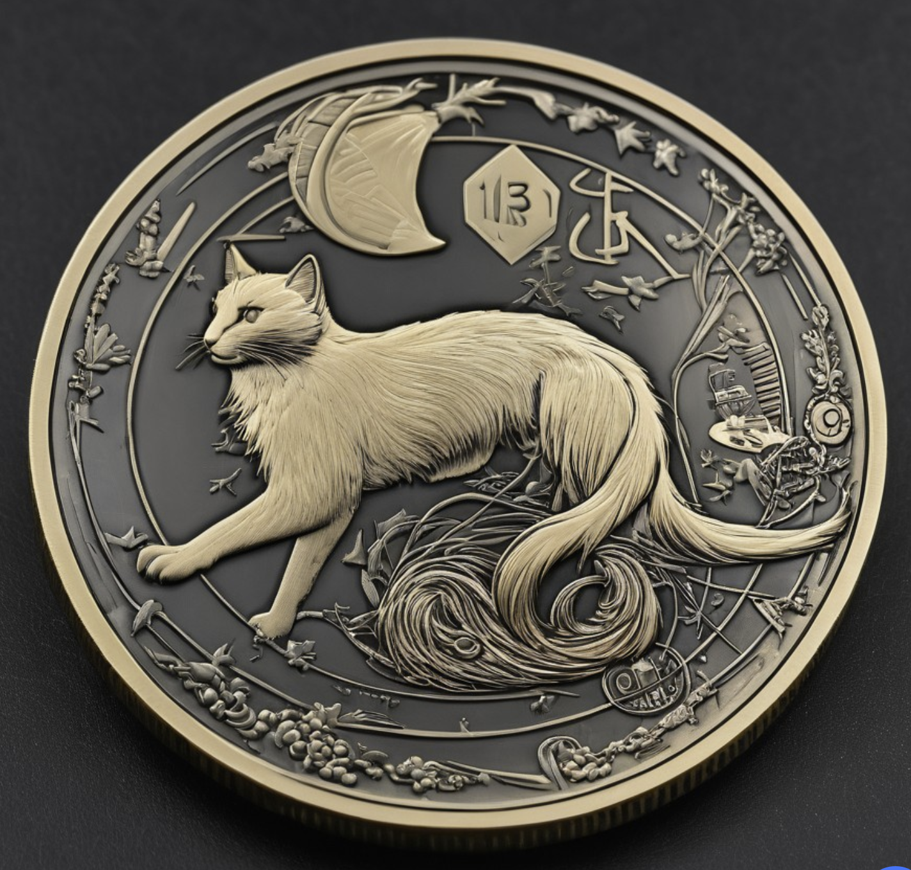
What is this other side of the coin?
What does IR logs and documents for the incident?

Slide 11
domain names
IPs
Hashes
emails
Mitre Txxx
behaviors
…..

Slide 12
We TAILed this list before

Slide 13

The intel we did not get ingest from others
The intel about attackers who did a special effort – just for us
The intel which maybe shows us weaknesses we never suspected

Slide 14
Every CTI team’s dream come true
Relevant intel

Slide 15
Enrichements

Slide 16

Enrichements
What are they?
Best intel is your intel … enriched with qualifications and other intel available
Ideally automation feeds back into automated hunts

Slide 17
COnclusions
Automate as much as possible
Have fun hunting
Document evidence
Intel produced should be evidence-based intel

Slide 18


Thank you
Questions ?

